Slide 1
What is camera consciousness & why does it matter?
In early visual anthropology, camera consciousness was defined as a barrier to be overcome in finding the ‘true’ character of the people before the camera.
Gregory Bateson and Margaret Mead pioneered visual data analysis as a means of both data capture and visual sense-making – to ‘reveal’ the character of the Balinese people.
Central to their technique was “the fact that we never asked to take pictures,” and associated with this element of surprise was the use of “an angular viewfinder for when the subject might be expected to dislike being photographed at that particular moment.”
Consider these techniques in the age of automation.
(Bateson & Mead, 1942, Balinese Character: A photographic analysis)

Slide 2
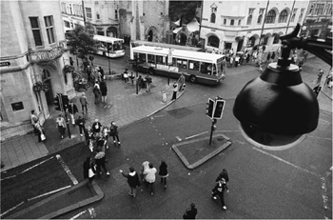
Elements of camera consciousness
Awareness of camera devices and an affective relationship with them
The camera’s function in transforming the world as visual data
Camera ‘intelligence’: the capacity for machine vision, deep learning, image processing
New operational and communicative qualities of the digital image
The distribution of vision and points of view
Visibility as a commodity within an unevenly distributed (social) media ecosystem
The dual sense of augmentation and anxiety in the relationship we have to cameras and the value of images as visual data
Notes:
Figure 5.1 Oxford city centre, overseen by closed circuit TV camera; the camera itself is inside the dark bubble (right foreground) and shielded from public view. Late 1990s. Photographer: Richard White. ‘Making Images’ In: Visual Methods in Social Research BOOK
By: Marcus Banks Published: 2001. DOI: https://dx.doi.org/10.4135/9780857020284.n5. Print ISBN: 9780761963646 | Online ISBN: 9780857020284
Online Publication Date: January 1, 2011
Disciplines: Anthropology, Business and Management, Communication and Media Studies, Counseling and Psychotherapy, Criminology and Criminal Justice, Education, Geography, Health, History, Marketing, Nursing, Political Science and International Relations, Psychology, Social Policy and Public Policy, Social Work, Sociology
Abstract: There has been an explosion of interest in visual culture - coming largely from work in sociology, anthropology and cultural studies and while there are a number of practical and technical manuals available for film, photographic and other visual media, there is a dearth of writing that combines both the practical and the technical. This book redresses this with a balanced approach that is written primarily for students in the social sciences who wish to use visual materials in the course of empirical, qualitative field research. It should also be of interest to experienced researchers who wish to expand their methodological approaches. Visual methods provides empirical approaches to both image creation and image analysis, drawing on a wide range of examples: from research conducted on ...
Camera Consciousness Theory
Radical empiricism (William James)
The “semi-subjectivity” of the camera in what Deleuze called pure optical and sound situations
The vitality and thing-power of objects & images (Bennett 2009; Connolly 2011; ANT; Kember & Zylinska 2012)
The non-human in media theory, and materiality in communication research (Grusin ed. 2015; Packer & Crofts Wiley 2012; Gillespie etal. 2013)
The dual sense of augmentation and anxiety in the relationship we have to cameras and the spreadability of images as data.
My approach is informed by:
The tenets of radical empiricism - mobilised so well by Adrian Mackenzie in his still amazing book on Wirelessness. And wireless relations key to how drones work...
What Deleuze saw the 'semi-subjectivity' of the camera in what he called the pure optical and sound situations of post-war Italian neo-realist cinema.
The vitality and thing-power of objects (Bennett, Connolly, et al.) and a turn to the non-human in media theory, and materiality in communication research

Slide 3
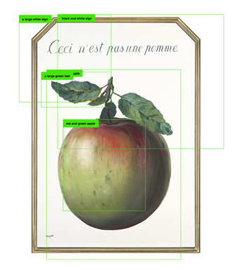
Semiotics as technique: accounting for machine vision
Peircean semiotics (triadic):
meaning making happens actively in the relationship between:
(a) sign (/ sign-vehicle) word, image, pixel or group of pixels within an image
(b) object, a thing in the world or an abstract idea or concept
(c) interpretant, interpretation + interpreter
Visual literacy, once a human or animal competency, is now shared with machines. We can gain ‘oversight’ by using semiotic analysis on the components of artificial visual systems
Sharing visual analysis:
Encounters with sign-objects involve “a tension between our ability to imbue the world with meaning and the world’s resistance to such attempts.”
Iddo Tavory and Stefan Timmermans: Abductive Analysis
Eg: Excavating AI (Crawford & Paglen)
Notes:
a sign (/ sign-vehicle), which could be a word, an image, or even a pixel or group of pixels within an image, (b) an object, which could be a thing in the world or an abstract idea or concept, and (c) an interpretant, perhaps best understood as a combination of an interpretation and the interpreter
I define a sign as anything which is so determined by something else, called its Object, and so determines an effect upon a person, which effect I call its interpretant, that the latter is thereby mediately determined by the former.
John Debes: Visual Literacy: human competencies that enable a person to “discriminate and interpret the visible actions, objects, symbols” they encountered in their environment.
Where do we go? In addition to regulation and political economic and platform critique:: Visual literacies (& digital & data literacies) as pathways to intervention;
We need to tend to the dual evolution of camera consciousness - as something we are (or should be) experiencing alongside and with machines. Training visual literacies; data sets etc. Has several components or strategies:
Intervene in the semiotic chains… Locate the interpretant (where and among whom interpretation happens), the component parts or sign vehicles, and build toward inclusion, fairness, harm reduction…
First, social learning or public pedagogy as crucial: socialising machine learning. [Because platforms are not helping, and governments need our input and direction!!]

